Slide 1
Naloxone
Administration Training
for the End User

Slide 2
Introduction
This video provides counseling information on the administration of naloxone. If you have any questions after viewing the video, please ask the individual giving the naloxone to you.
At the end of this video, you should be able to:
Describe what an opioid drug is and why naloxone is given
Recognize when naloxone should be administered
Understand how to administer naloxone
Describe what steps to take after naloxone is given

Slide 3
You Can Save a Life
Choosing to obtain naloxone is the first step in saving the life of someone who has overdosed on an opioid drug. Thank you for taking this important step!
If you ever need to administer the naloxone you receive, make sure to obtain more naloxone so that you can continue to be prepared.
Naloxone can only save a life if it is stored in a location that you can get to easily and quickly. Decide where yours should be kept.

Slide 4
What is an Opioid?
The word “opioid” is used to describe a group of drugs that act in the same place in the body to relieve pain. The place where these drugs work is called the opioid receptor.
Opioid drugs may be sold legally as a prescription or illegally on the street (for example, heroin).
In addition to helping to relieve pain, these drugs have side effects like sleepiness. In an overdose, toxic effects occur when there is:
An inability to wake the person up
Decreased breathing or breathing stops

Slide 5
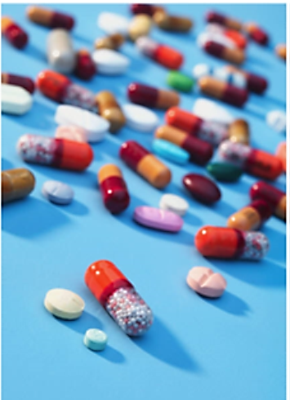
Examples of Opioids
Heroin
Carfentanil
Codeine (in Tylenol #3)
Fentanyl (prescription and home made)
Hydrocodone (in Vicodin)
Hydromorphone (Dilaudid)
Meperidine (Demerol)
Morphine
Oxycodone (in Percocet/Percodan)
Oxymorphone
Tapentadol (Nucynta)
Tramadol (Ultram)
U47700 (street name, Pink)

Slide 6
How Does Naloxone Work?
Naloxone is an antidote that removes the opioid drug from the site in the brain where the opioid needs to attach in order to work.
When naloxone wears off, the opioid drug can attach again.
When the opioid drug is no longer attached, breathing will return to normal as long as the person has not stopped breathing for too long.
Breathing can return to normal before the person is fully awake.
If the person receiving naloxone is breathing again, naloxone did its job.

Slide 7
Naloxone Administration
If an opioid overdose is suspected, or you are not sure, you will administer naloxone.
Do not put the person in ice water or pour cold water on them. Doing this puts their heart at risk of injury.
There are two doses in each naloxone package. The dose you will be giving is enough to work even if your technique is not perfect.
By calling 911, you will have a back up who will also have more naloxone if necessary and who will have experience managing overdoses. You may be nervous if you have not administered naloxone before, but you will have help coming.

Slide 8
Naloxone Administration Checklist (cont.’d)
Steps to administer naloxone:
Place the person flat on their back. If you cannot move them safely, make sure their head is straight.
Direct someone to CALL 911 or do it yourself.
Administer a dose of naloxone.
If possible, rescue breathing should be done until the patient begins breathing again.
If the person is still not breathing well after 3 minutes, repeat the dose.
If the person starts to vomit, turn them onto their side so the vomit does not choke them.
If the person starts to breathe or wake up, move away to put some space between you and the person. Waking up from an overdose can cause some people to get very agitated and confused. You may accidently get hit if you are close.
Stay with the person until emergency medical services arrive.

Slide 9
Naloxone Is Not an Antidote For All Drugs
Remember, naloxone will NOT stop the effects of drugs that are not opioids. Examples of common drugs that are not opioids include: alcohol, cocaine, methamphetamine, ecstasy (Molly), sedatives/tranquilizers, marijuana, and “bath salts.”

Slide 10
Side Effects of Naloxone
If a person is not breathing or not breathing well, the chance that naloxone will save their life is more important than possible side effects.
If the person receiving naloxone has been taking opioids for a long time, naloxone can cause them to go into withdrawal:
Runny nose
Sweating
Racing heart
Shakes
Nausea and vomiting
Rapid return of pain (if using for pain)
Agitation or violence
Fear of causing withdrawal should NEVER prevent use when the person is not breathing or not breathing well.

Slide 11
Additional Steps
Many other drugs and medical problems can look like an opioid overdose. Persons who start breathing again after naloxone is given may have other important medical problems you cannot see. ALWAYS call 911.
Call the West Virginia Poison Center to report the use of naloxone. The Poison Specialists will be able to determine if there is anything else you need to do while you wait for EMS to arrive.
West Virginia Poison Center: 1-800-222-1222
West Virginia state law requires that naloxone administration be reported. Reporting can be confidential if you are afraid for your safety.

Slide 12
Types of Naloxone
Evzio Auto-injector
2 mg dose of naloxone injected into the outer thigh
Naloxone Nasal via Atomizer
2 mg dose sprayed into the nostrils (half in each nostril)
Narcan Nasal Spray
4 mg dose sprayed into one nostril

Slide 13
Information For All Three Devices
West Virginia allows all of these devices to be used in both adults and children.
All of these devices can be carried in a purse, bag, or backpack or stored in a drawer or cabinet.
After the devices are used, hand the empty device(s) to EMS.
EMS will use the empty devices to verity the dose given.
EMS will dispose of the used devices safely.

Slide 14
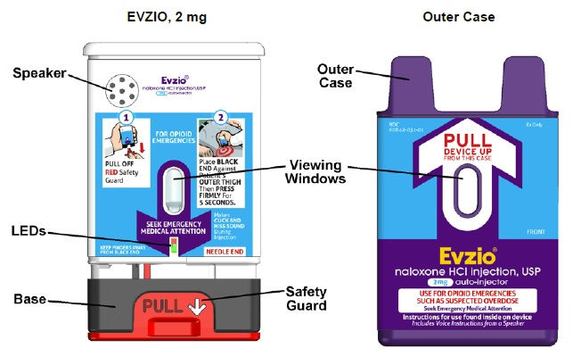
Naloxone Auto-Injector
Evzio (naloxone hydrochloride injection) delivers a single 2 mg dose of the drug naloxone via a hand-held auto-injector.

Slide 15
Evzio Administration
https://www.youtube.com/watch?v=-B_ZO_MUGBE

Slide 16
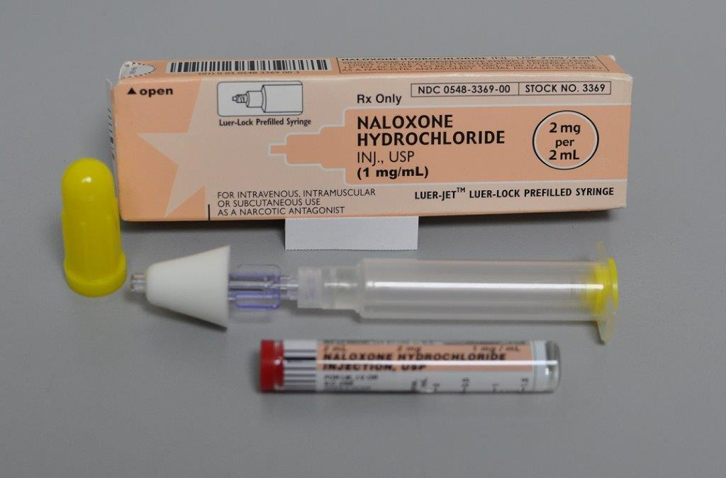
Nasal Naloxone via Atomizer
Product delivers a 2 mg dose of naloxone into the nasal cavity.
Kit requires assembly.

Slide 17
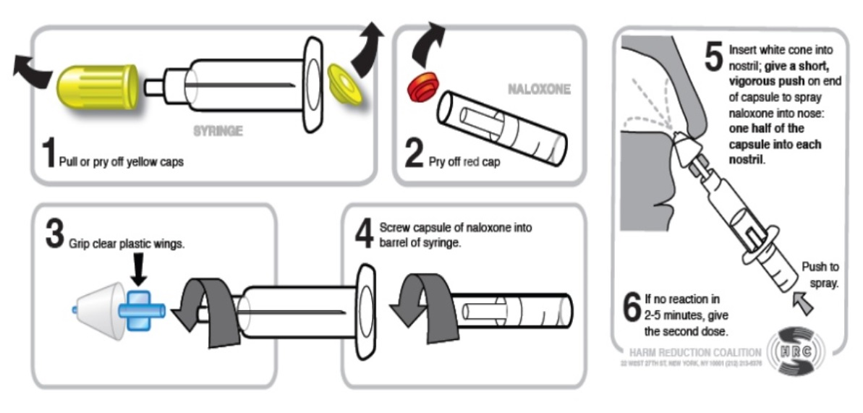
Naloxone With Atomizer Administration
https://www.youtube.com/watch?v=BHNelucT728
Notes:
https://www.youtube.com/watch?v=Jis6NlZMV2c

Slide 18
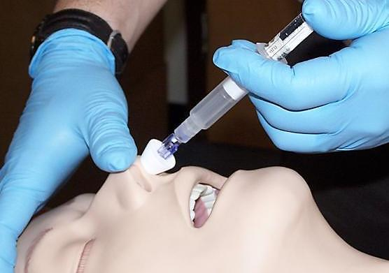
Nasal Atomizer Use
The atomizer can NEVER be washed and re-used later.
Re-use is a risk for disease transmission.
The small pores will become clogged resulting in too small of a dose being given.
https://bha.health.maryland.gov/NALOXONE/Pages/Naloxone.aspx

Slide 19
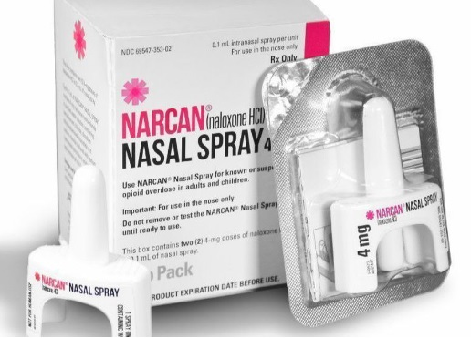
Narcan Nasal Spray
Narcan is a brand name of naloxone and is produced by Adapt Pharma Inc. The naloxone comes in a spray device designed to deliver a 4 mg dose into a single nostril.

Slide 20
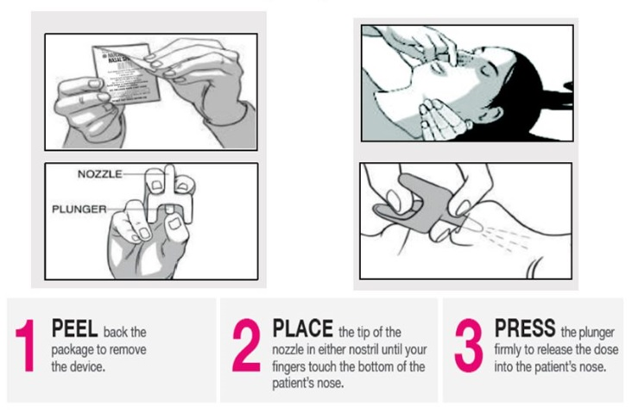
Narcan Nasal Spray Administration
https://www.youtube.com/watch?v=xa7X00_QKWk

Slide 21
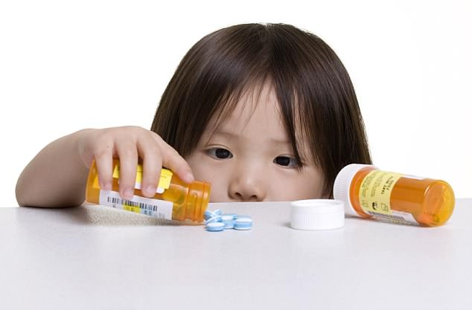
Children Can Also Overdose
When an opioid overdose is suspected in a child, naloxone can still be used.
You cannot overdose a child with naloxone. You can save their life.
If using Evzio in a child, pinch the thigh between your finger and thumb and inject into the pinched area.

Slide 22
The Law Protects Whoever Calls for Emergency Help
But only if 911 is called. GET HELP, DIAL 911.
Any person who administers an opioid antagonist in good faith to someone they believe to be suffering from an opioid-related overdose is not subject to criminal prosecution arising from the possession of an opioid antagonist or subject to any civil liability with respect to the administration of or failure to administer the opioid antagonist unless the act or failure to act was the result of gross negligence or willful misconduct.
Source:§16-46-5 (c)

Slide 23
The Law Protects Whoever Calls for Emergency Help
Any person who administers an opioid antagonist to a person they believe to be suffering from an opioid-related overdose is required to seek additional medical treatment at a medical facility for that person immediately following the administration of the opioid antagonist to avoid further complications from medical problems that are not obvious at the time.
Source:§16-46-5 (d)

Slide 24
Additional Information
Naloxone is dispensed with two informational brochures.
The first brochure contains key information from this video to use as a reminder of what you have learned.
The second brochure provides information to help you support those you know before and after an overdose occurs.

Slide 25
Questions and Additional Information
The individual providing naloxone to you will address questions you may have and will guide you to other resources you may need.
Sources for additional information can be found on the brochures you will receive with the naloxone.

